Slide 1
CSE 417T Introduction to Machine Learning
Lecture 19 Instructor: Chien-Ju (CJ) Ho

Slide 2
Logistics
No class on Nov 22 (Tuesday): The day before the thanksgiving break
Homework 4 was due yesterday
Homework 5 will be announced later today
This will be our last assignment
Keep track of your own late days
Gradescope doesn’t allow separate deadlines
Your submissions won’t be graded if you exceed the late-day limit
Please ask course-related questions on Piazza
I have been very behind on emails and don’t open all emails
However, I’ll try to check Piazza regularly

Slide 3
Recap

Slide 4
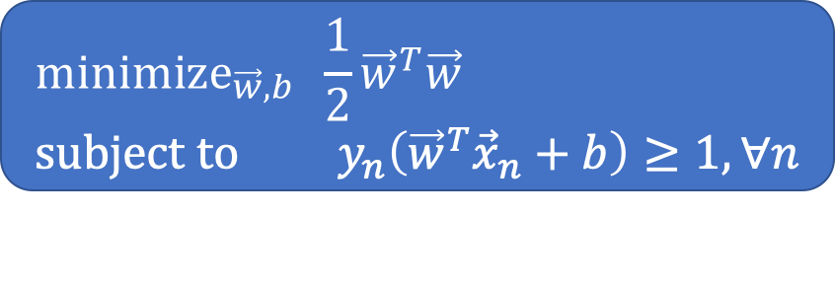
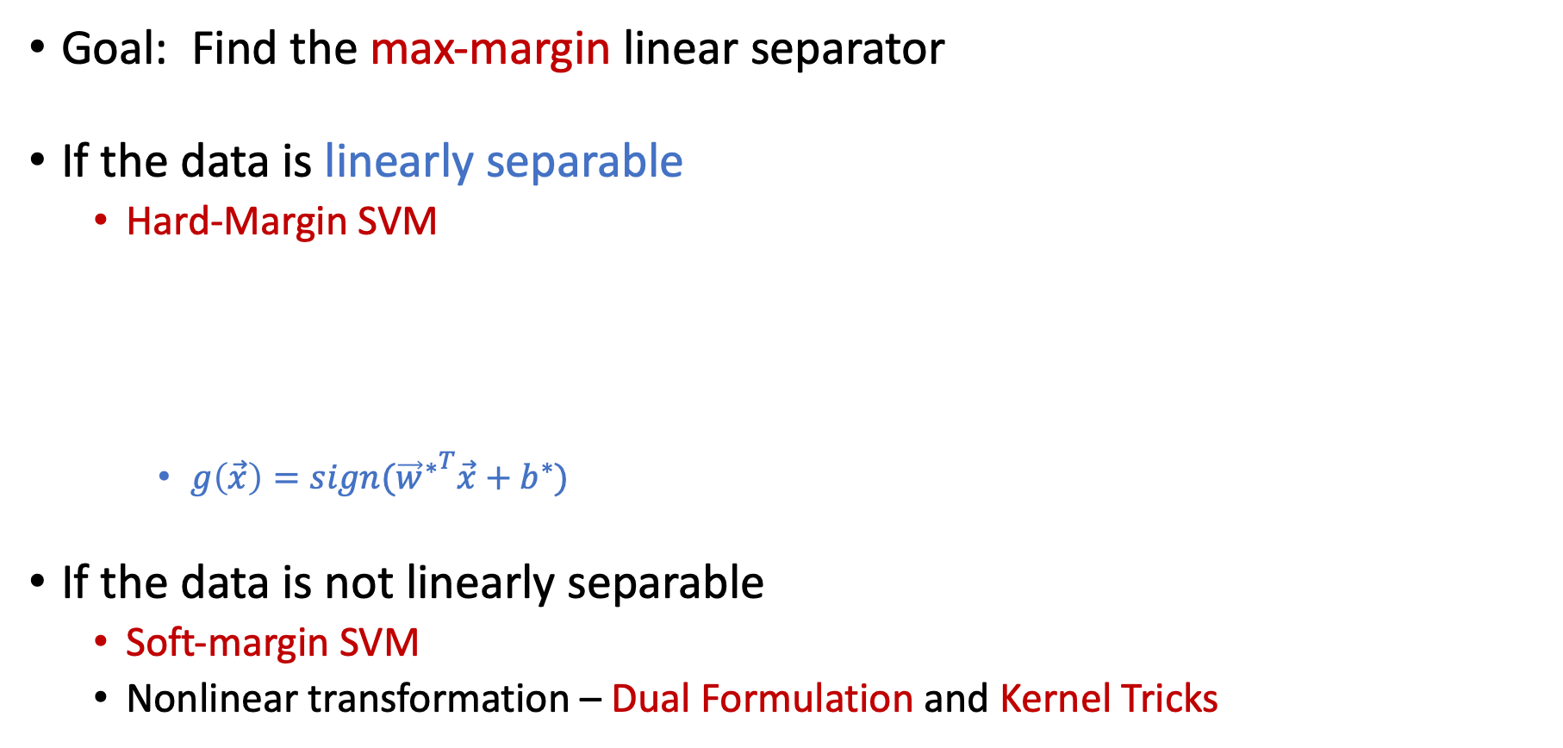
Support Vector Machines
Goal: Find the max-margin linear separator
If the data is linearly separable
Hard-Margin SVM (Assume data is linearly separable)
$g\left(\vec{x}\right)=sign({{\vec{w}}^{∗}}^{T}\vec{x}+b^{∗})$
If the data is not linearly separable
Soft-margin SVM
Nonlinear transformation – Dual Formulation and Kernel Tricks
Margin
$${\text{minimize}}_{\vec{w},b} \frac{1}{2}{\vec{w}}^{T}\vec{w} \\ \text{subject} \text{to} y_{n}\left({\vec{w}}^{T}{\vec{x}}_{n}+b\right)≥1, ∀n$$

Slide 5
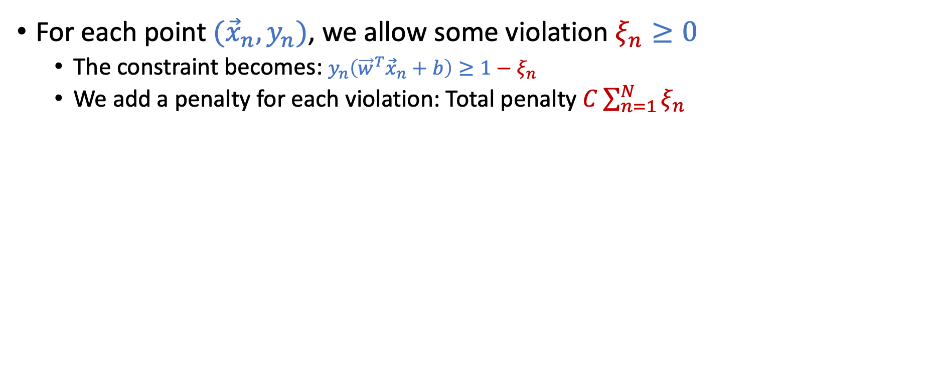
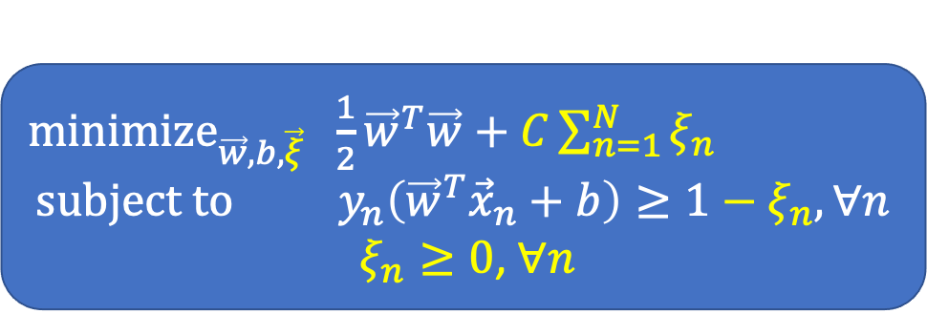
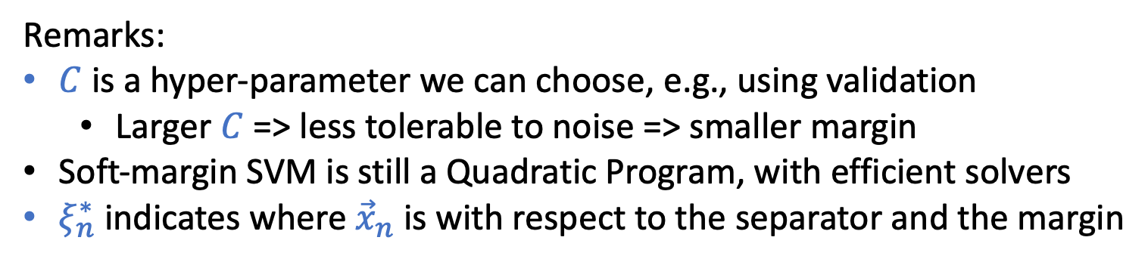
Soft-Margin SVM
For each point $({\vec{x}}_{n},y_{n})$, we allow some violation $ξ_{n}≥0$
The constraint becomes: $y_{n}\left({\vec{w}}^{T}{\vec{x}}_{n}+b\right)≥1−ξ_{n}$
We add a penalty for each violation: Total penalty $C\sum_{n=1}^{N}{ξ_{n}}$
${\text{minimize}}_{\vec{w},b,\vec{ξ}} \frac{1}{2}{\vec{w}}^{T}\vec{w}+C\sum_{n=1}^{N}{ξ_{n}}$ $$\text{subject} \text{to} y_{n}\left({\vec{w}}^{T}{\vec{x}}_{n}+b\right)≥1−ξ_{n}, ∀n$$
$ξ_{n}≥0$, $∀n$
Remarks:
$C$ is a hyper-parameter we can choose, e.g., using validation
Larger $C$ => less tolerable to noise => smaller margin
Soft-margin SVM is still a Quadratic Program, with efficient solvers
$ξ_{n}^{∗}$ indicates where ${\vec{x}}_{n}$ is with respect to the separator and the margin

Slide 6
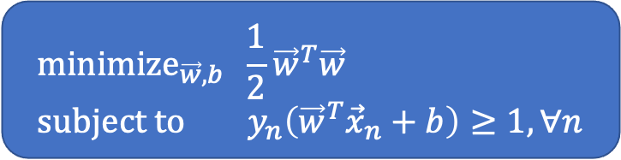
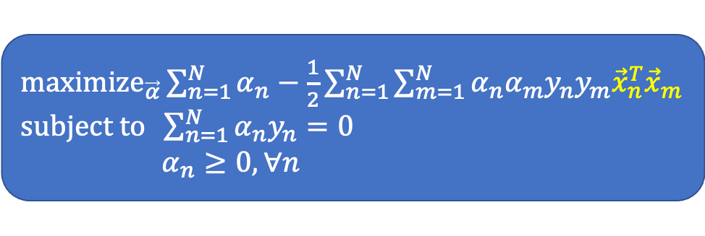
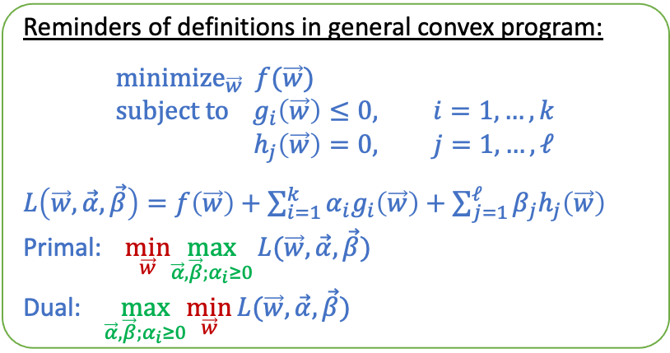
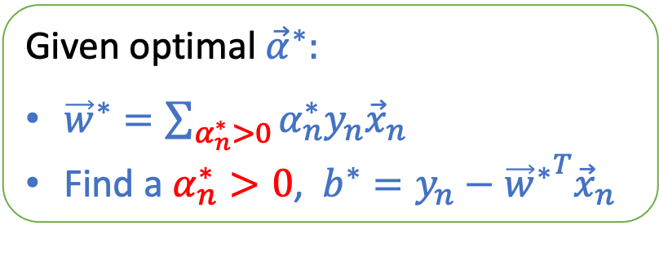
Primal-Dual Formulations of Hard-Margin SVM
Primal
Dual
Key messages:
Both can be efficiently solved using QP solver
We can infer the solution from one to the other
Reminders of definitions in general convex program:
$${\text{minimize}}_{\vec{w}} f(\vec{w}) \\ \text{subject} \text{to} g_{i}\left(\vec{w}\right)≤0, i=1,…,k \\ h_{j}\left(\vec{w}\right)=0, j=1,…,ℓ$$
$L\left(\vec{w},\vec{α},\vec{β}\right)=f\left(\vec{w}\right)+\sum_{i=1}^{k}{α_{i}g_{i}\left(\vec{w}\right)+\sum_{j=1}^{ℓ}{β_{j}h_{j}\left(\vec{w}\right)}}$
Primal: $\min_{\vec{w}}\max_{\vec{α},\vec{β};α_{i}≥0}{L(\vec{w},\vec{α},\vec{β})}$
Dual: $\max_{\vec{α},\vec{β};α_{i}≥0}\min_{\vec{w}}{L(\vec{w},\vec{α},\vec{β})}$
$${\text{minimize}}_{\vec{w},b} \frac{1}{2}{\vec{w}}^{T}\vec{w} \\ \text{subject} \text{to} y_{n}\left({\vec{w}}^{T}{\vec{x}}_{n}+b\right)≥1, ∀n$$
${\text{maximize}}_{\vec{α}}\sum_{n=1}^{N}{α_{n}}−\frac{1}{2}\sum_{n=1}^{N}{\sum_{m=1}^{N}{α_{n}α_{m}y_{n}y_{m}{\vec{x}}_{n}^{T}{\vec{x}}_{m}}}$ $\text{subject} \text{to} \sum_{n=1}^{N}{α_{n}y_{n}=0}$ $α_{n}≥0,∀n$
Given optimal ${\vec{α}}^{∗}:$
${\vec{w}}^{∗}=\sum_{α_{n}^{∗}>0}{α_{n}^{∗}y_{n}{\vec{x}}_{n}}$
Find a $α_{n}^{∗}>0$, $b^{∗}=y_{n}−{{\vec{w}}^{∗}}^{T}{\vec{x}}_{n}$

Slide 7
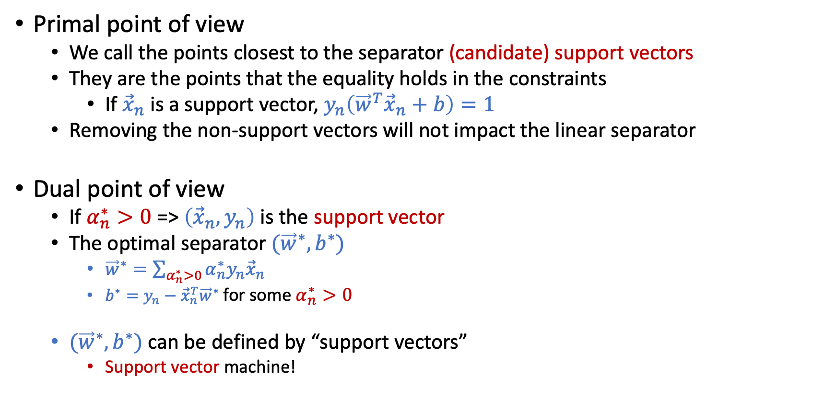
Support Vectors
Primal point of view
We call the points closest to the separator (candidate) support vectors
They are the points that the equality holds in the constraints
If ${\vec{x}}_{n}$ is a support vector, $y_{n}\left({\vec{w}}^{T}{\vec{x}}_{n}+b\right)=1$
Removing the non-support vectors will not impact the linear separator
Dual point of view
If $α_{n}^{∗}>0$ => $\left({\vec{x}}_{n},y_{n}\right)$ is the support vector
The optimal separator $({\vec{w}}^{∗},b^{∗})$
${\vec{w}}^{∗}=\sum_{α_{n}^{∗}>0}{α_{n}^{∗}y_{n}{\vec{x}}_{n}}$
$b^{∗}=y_{n}−{\vec{x}}_{n}^{T}{\vec{w}}^{∗}$for some $α_{n}^{∗}>0$
$({\vec{w}}^{∗},b^{∗})$ can be defined by “support vectors”
Support vector machine!

Slide 8
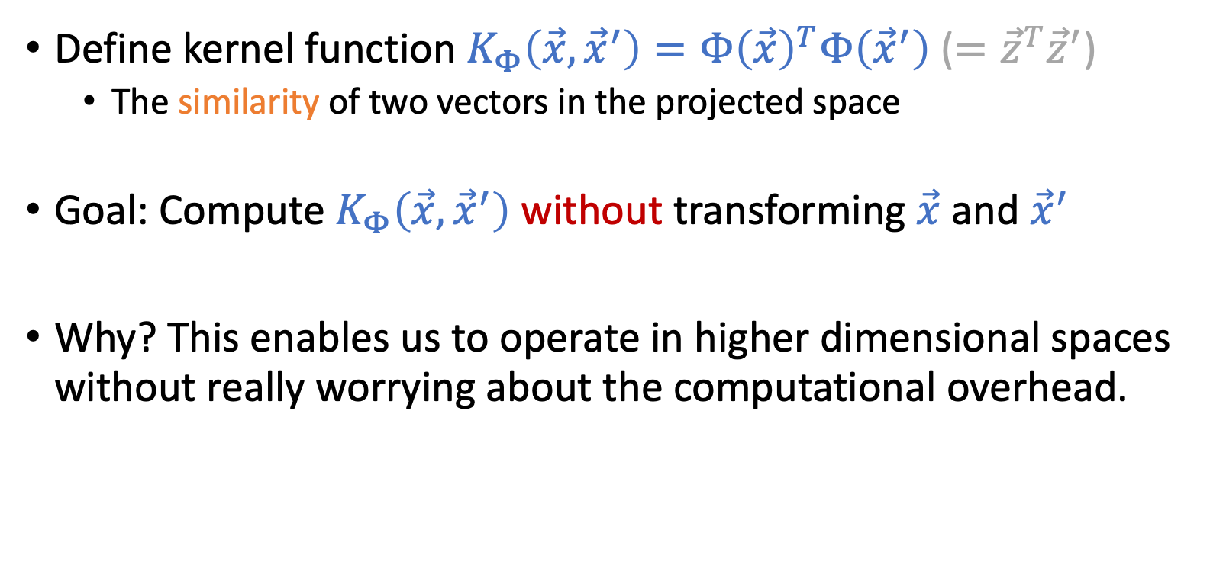
Nonlinear Transform and Kernel Tricks
Define kernel function $K_{Φ}\left(\vec{x},{\vec{x}}^{′}\right)=Φ{\left(\vec{x}\right)}^{T}Φ\left({\vec{x}}^{′}\right)$ ($={\vec{z}}^{T}{\vec{z}}^{′}$)
The similarity of two vectors in the projected space
Goal: Compute $K_{Φ}\left(\vec{x},{\vec{x}}^{′}\right)$ without transforming $\vec{x}$ and ${\vec{x}}^{′}$
Why? This enables us to operate in higher dimensional spaces without really worrying about the computational overhead.

Slide 9
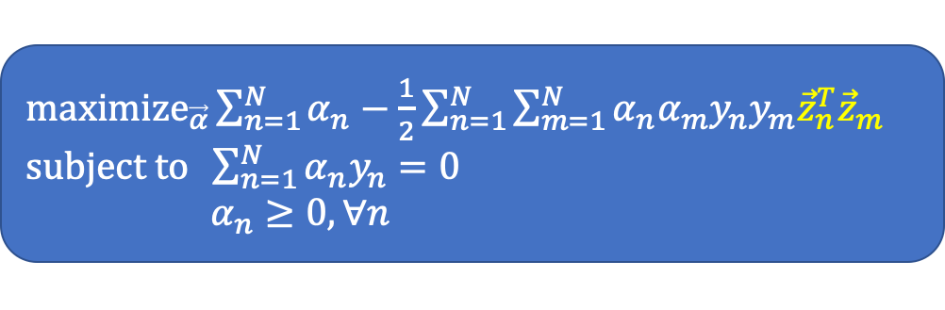
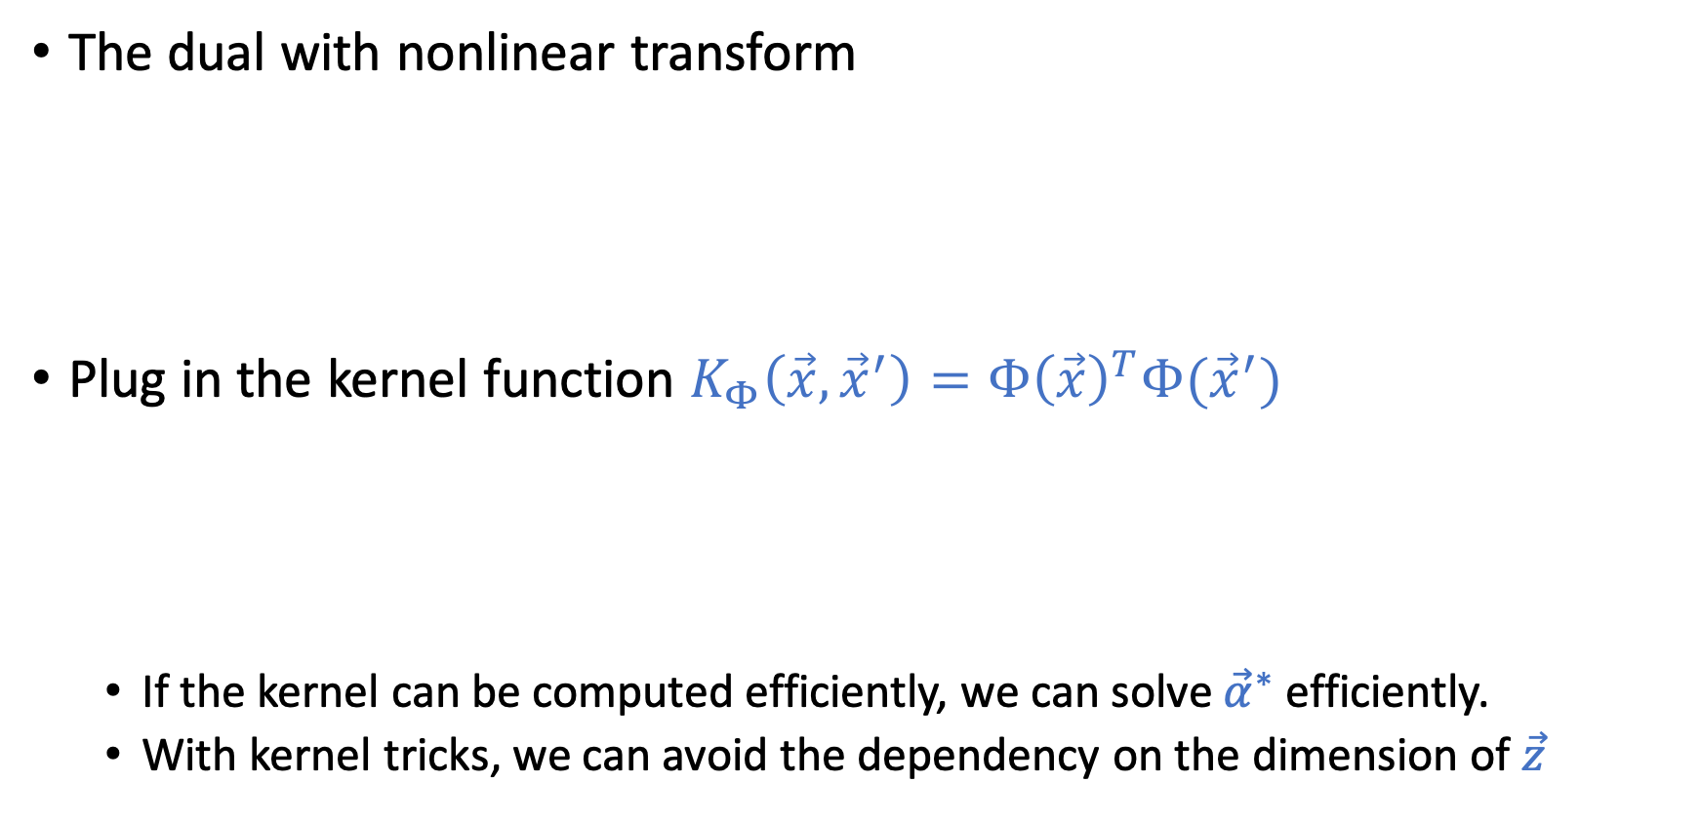
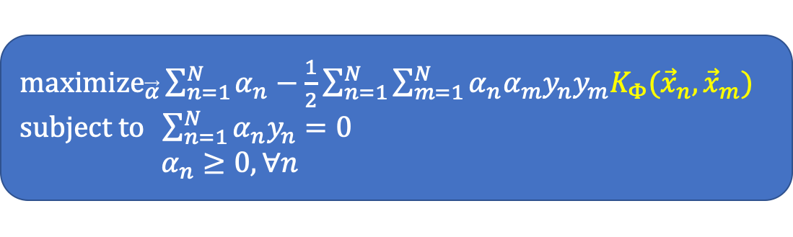
Kernel Trick: Utilize Dual and Kernel Functions
The dual with nonlinear transform
Plug in the kernel function $K_{Φ}\left(\vec{x},{\vec{x}}^{′}\right)=Φ{\left(\vec{x}\right)}^{T}Φ({\vec{x}}^{′})$
If the kernel can be computed efficiently, we can solve ${\vec{α}}^{∗}$ efficiently.
With kernel tricks, we can avoid the dependency on the dimension of $\vec{z}$
${\text{maximize}}_{\vec{α}}\sum_{n=1}^{N}{α_{n}}−\frac{1}{2}\sum_{n=1}^{N}{\sum_{m=1}^{N}{α_{n}α_{m}y_{n}y_{m}{\vec{z}}_{n}^{T}{\vec{z}}_{m}}}$ $\text{subject} \text{to} \sum_{n=1}^{N}{α_{n}y_{n}=0}$ $α_{n}≥0,∀n$
${\text{maximize}}_{\vec{α}}\sum_{n=1}^{N}{α_{n}}−\frac{1}{2}\sum_{n=1}^{N}{\sum_{m=1}^{N}{α_{n}α_{m}y_{n}y_{m}K_{Φ}({\vec{x}}_{n},{\vec{x}}_{m})}}$ $\text{subject} \text{to} \sum_{n=1}^{N}{α_{n}y_{n}=0}$ $α_{n}≥0,∀n$

Slide 10
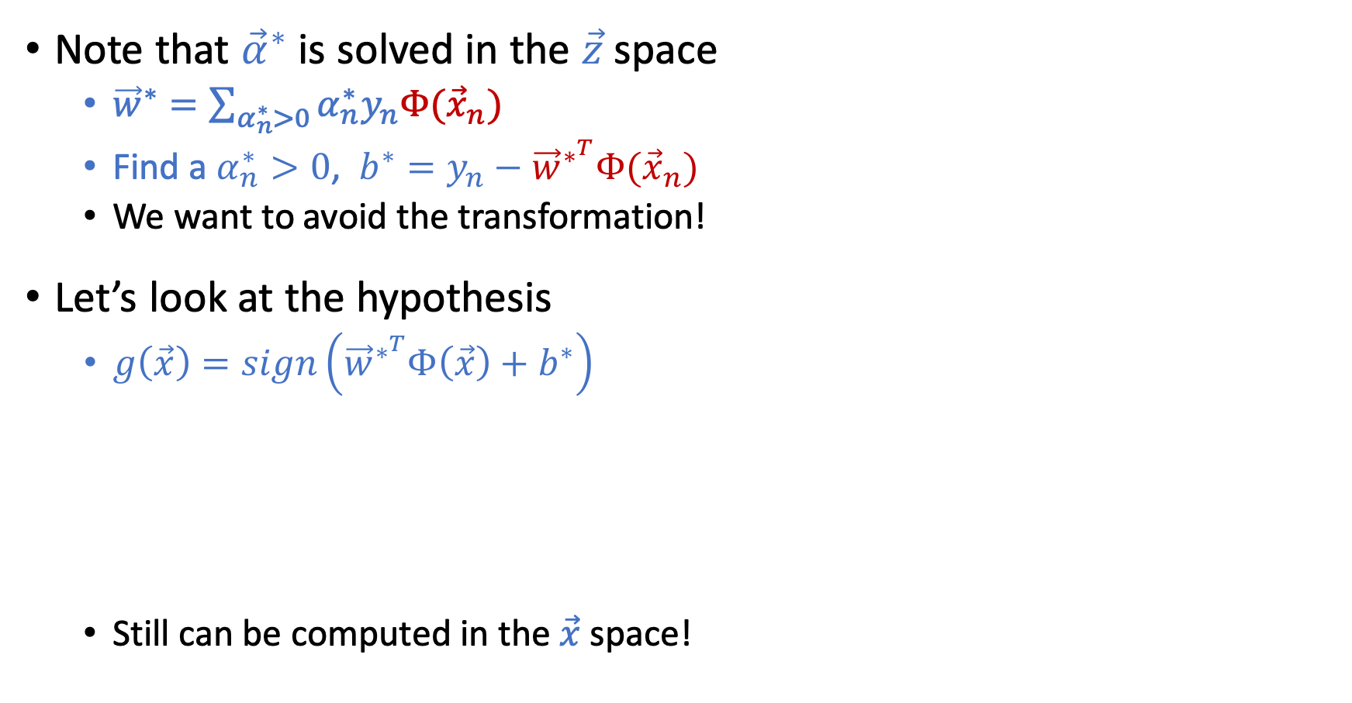

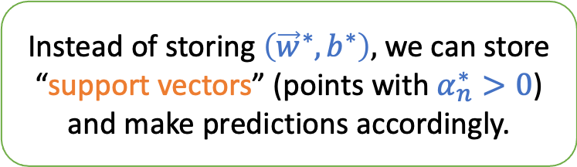
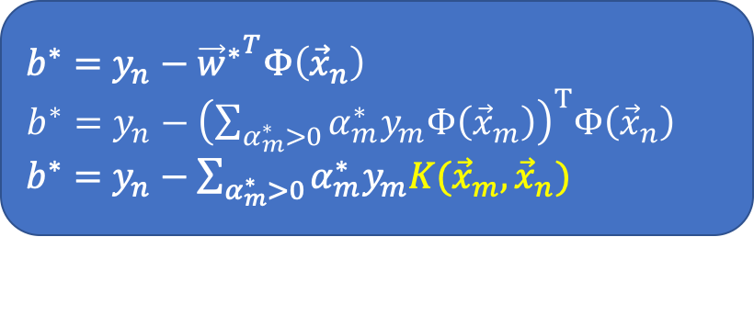
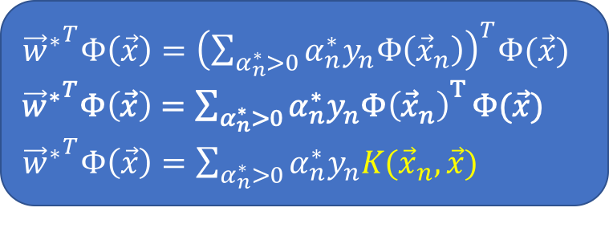
Recover $({\vec{w}}^{∗},b^{∗})$ from ${\vec{α}}^{∗}$ with Kernel Tricks
Note that ${\vec{α}}^{∗}$ is solved in the $\vec{z}$ space
${\vec{w}}^{∗}=\sum_{α_{n}^{∗}>0}{α_{n}^{∗}y_{n}Φ({\vec{x}}_{n})}$
Find a $α_{n}^{∗}>0$, $b^{∗}=y_{n}−{\vec{w}}^{∗^{T}}Φ({\vec{x}}_{n})$
We want to avoid the transformation!
Let’s look at the hypothesis
$g\left(\vec{x}\right)=sign\left({\vec{w}}^{∗^{T}}Φ\left(\vec{x}\right)+b^{∗}\right)$
Still can be computed in the $\vec{x}$ space!
Instead of storing $\left({\vec{w}}^{∗},b^{∗}\right),$ we can store “support vectors” (points with $α_{n}^{∗}>0$) and make predictions accordingly.
${{\vec{w}}^{∗}}^{T}Φ\left(\vec{x}\right)={\left(\sum_{α_{n}^{∗}>0}{α_{n}^{∗}y_{n}Φ\left({\vec{x}}_{n}\right)}\right)}^{T}Φ(\vec{x})$
${{\vec{w}}^{∗}}^{T}Φ\left(\vec{x}\right)={\sum_{α_{n}^{∗}>0}{α_{n}^{∗}y_{n}Φ\left({\vec{x}}_{n}\right)}}^{T}Φ(\vec{x})$
${{\vec{w}}^{∗}}^{T}Φ\left(\vec{x}\right)={\sum_{α_{n}^{∗}>0}{α_{n}^{∗}y_{n}K({\vec{x}}_{n},\vec{x})}}^{}$
$b^{∗}=y_{n}−{{\vec{w}}^{∗}}^{T}Φ\left({\vec{x}}_{n}\right)$
$b^{∗}=y_{n}−{\left(\sum_{α_{m}^{∗}>0}{α_{m}^{∗}y_{m}Φ\left({\vec{x}}_{m}\right)}\right)}^{T}Φ\left({\vec{x}}_{n}\right)$
$b^{∗}=y_{n}−\sum_{α_{m}^{∗}>0}{α_{m}^{∗}y_{m}K({\vec{x}}_{m},{\vec{x}}_{n})}$

Slide 11
Today’s Lecture
The notes are not intended to be comprehensive. They should be accompanied by lectures and/or textbook.
Let me know if you spot errors.
Notes:
This is the lecture I wish I have 6 chalkboards to utilize

Slide 12
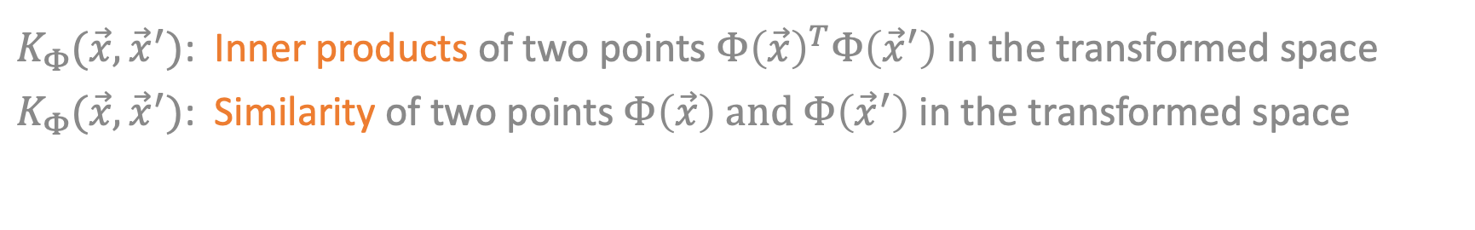
Kernel Functions
$K_{Φ}(\vec{x},{\vec{x}}^{′})$: Inner products of two points $Φ{\left(\vec{x}\right)}^{T}Φ\left({\vec{x}}^{′}\right)$in the transformed space
$K_{Φ}(\vec{x},{\vec{x}}^{′})$: Similarity of two points $Φ\left(\vec{x}\right) \text{and} Φ\left({\vec{x}}^{′}\right)$in the transformed space

Slide 13
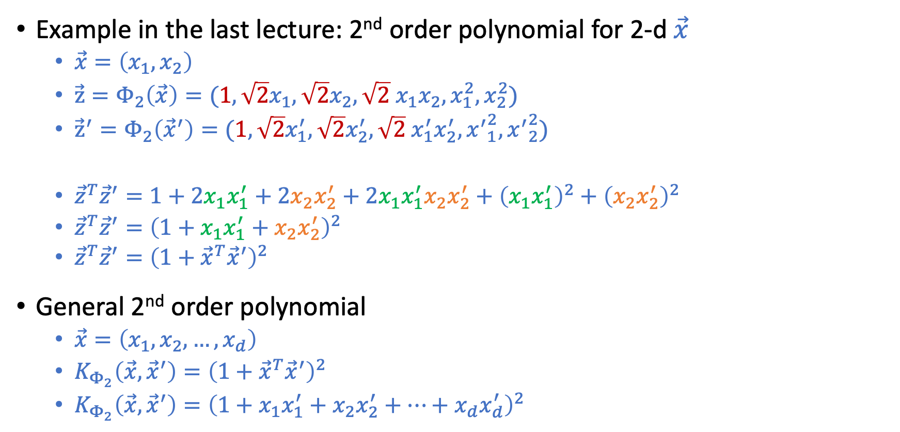
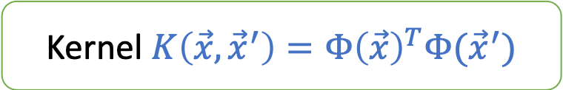
Polynomial Kernel
Kernel $K\left(\vec{x},{\vec{x}}^{′}\right)=Φ{\left(\vec{x}\right)}^{T}Φ({\vec{x}}^{′})$
Example in the last lecture: 2nd order polynomial for 2-d $\vec{x}$
$\vec{x}=\left(x_{1},x_{2}\right)$
${\vec{z}=Φ}_{2}\left(\vec{x}\right)=({1,\sqrt{2}x}_{1},{\sqrt{2}x}_{2},\sqrt{2}{ x}_{1}x_{2},x_{1}^{2},x_{2}^{2})$
${{\vec{z}}^{′}=Φ}_{2}\left({\vec{x}}^{′}\right)=(1,{\sqrt{2}x}_{1}^{′},\sqrt{2}x_{2}^{′},\sqrt{2}{ x}_{1}^{′}x_{2}^{′},{x^{′}}_{1}^{2},{x^{′}}_{2}^{2})$
${\vec{z}}^{T}{\vec{z}}^{′}=1+2x_{1}x_{1}^{′}+2x_{2}x_{2}^{′}+2x_{1}x_{1}^{′}x_{2}x_{2}^{′}+{\left(x_{1}x_{1}^{′}\right)}^{2}+{\left(x_{2}x_{2}^{′}\right)}^{2}$
${\vec{z}}^{T}{\vec{z}}^{′}={\left(1+x_{1}x_{1}^{′}+x_{2}x_{2}^{′}\right)}^{2}$
${\vec{z}}^{T}{\vec{z}}^{′}={\left(1+{\vec{x}}^{T}{\vec{x}}^{′}\right)}^{2}$
General 2nd order polynomial
$\vec{x}=\left(x_{1},x_{2},…,x_{d}\right)$
$K_{Φ_{2}}\left(\vec{x},{\vec{x}}^{′}\right)={\left(1+{\vec{x}}^{T}{\vec{x}}^{′}\right)}^{2}$
$K_{Φ_{2}}\left(\vec{x},{\vec{x}}^{′}\right)={\left(1+x_{1}x_{1}^{′}+x_{2}x_{2}^{′}+…+x_{d}x_{d}^{′}\right)}^{2}$

Slide 14
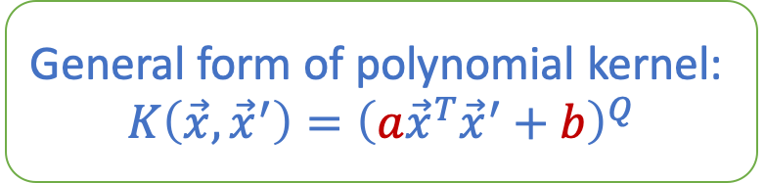
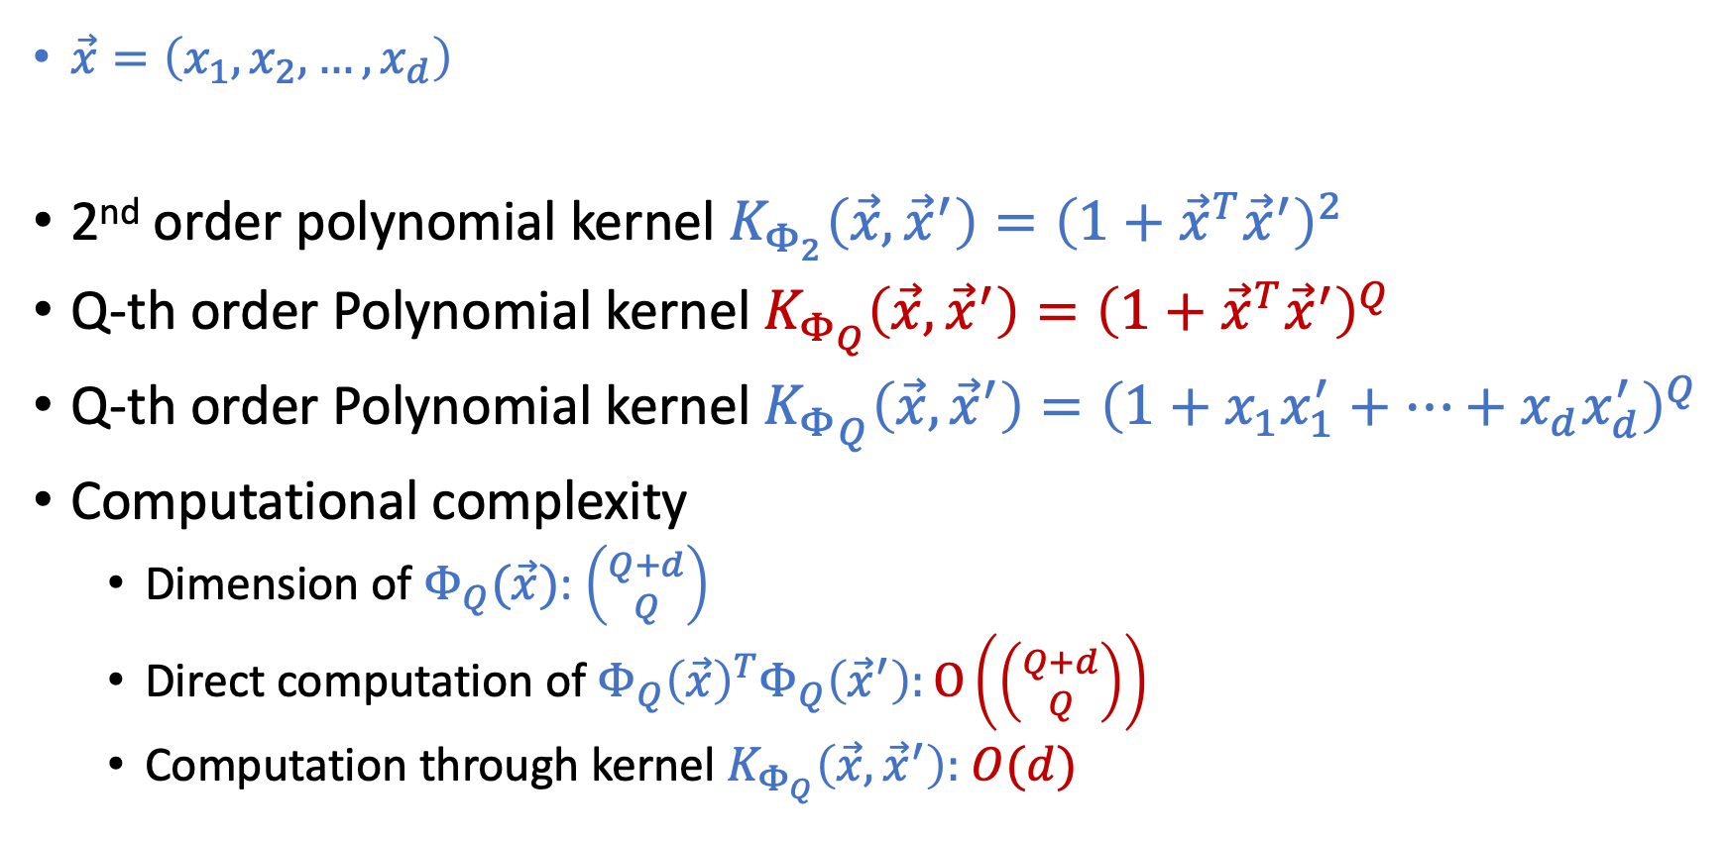
Polynomial Kernel
General form of polynomial kernel:
$$K\left(\vec{x},{\vec{x}}^{′}\right)={\left(a{\vec{x}}^{T}{\vec{x}}^{′}+b\right)}^{Q}$$
$\vec{x}=\left(x_{1},x_{2},…,x_{d}\right)$
2nd order polynomial kernel $K_{Φ_{2}}\left(\vec{x},{\vec{x}}^{′}\right)={\left(1+{\vec{x}}^{T}{\vec{x}}^{′}\right)}^{2}$
Q-th order Polynomial kernel $K_{Φ_{Q}}\left(\vec{x},{\vec{x}}^{′}\right)={\left(1+{\vec{x}}^{T}{\vec{x}}^{′}\right)}^{Q}$
Q-th order Polynomial kernel ${K_{Φ}}_{Q}\left(\vec{x},{\vec{x}}^{′}\right)={\left(1+x_{1}x_{1}^{′}+…+x_{d}x_{d}^{′}\right)}^{Q}$
Computational complexity
Dimension of $Φ_{Q}(\vec{x})$: $\left({Q+d \atop Q}\right)$
Direct computation of $Φ_{Q}{\left(\vec{x}\right)}^{T}Φ_{Q}\left({\vec{x}}^{′}\right):O\left(\left({Q+d \atop Q}\right)\right)$
Computation through kernel $K_{Φ_{Q}}\left(\vec{x},{\vec{x}}^{′}\right):$ $O(d)$

Slide 15
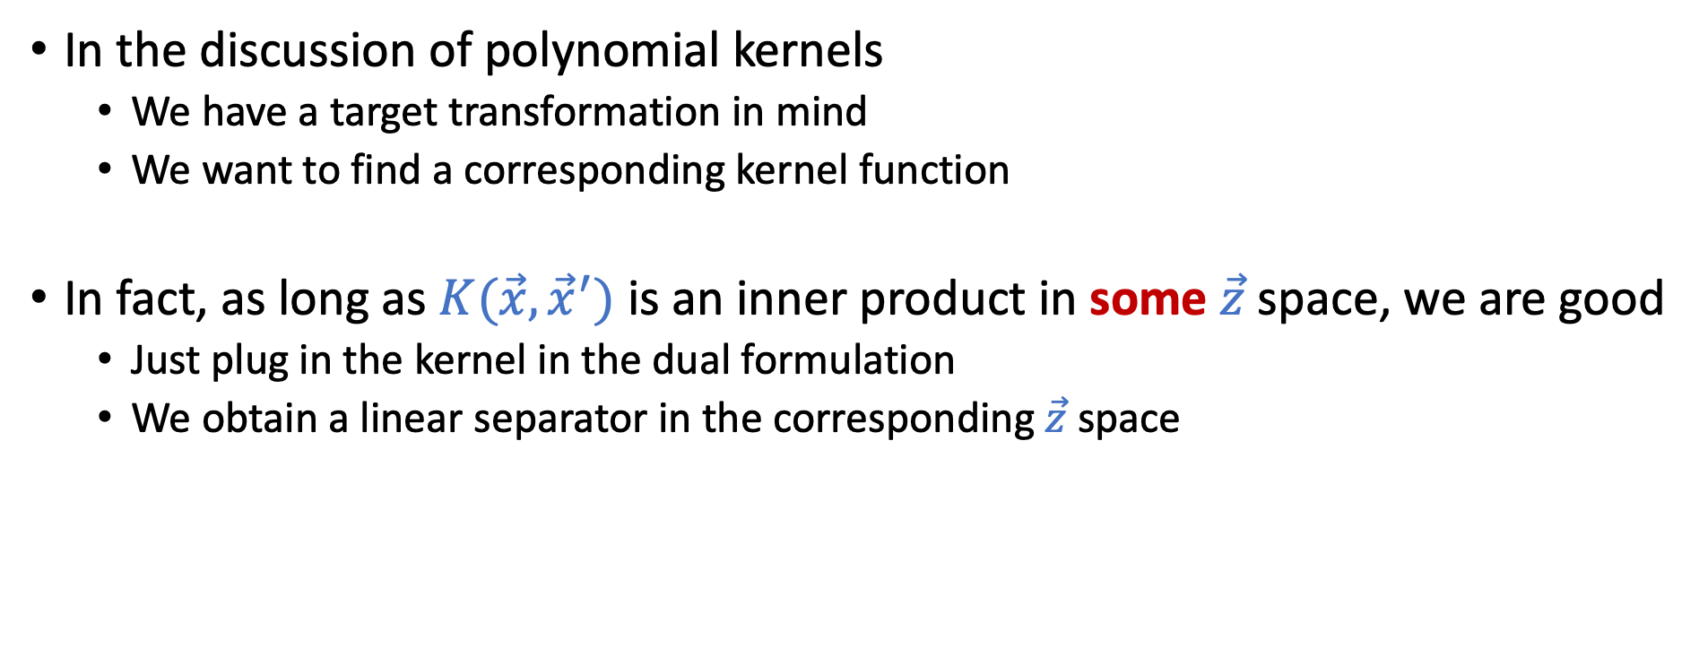

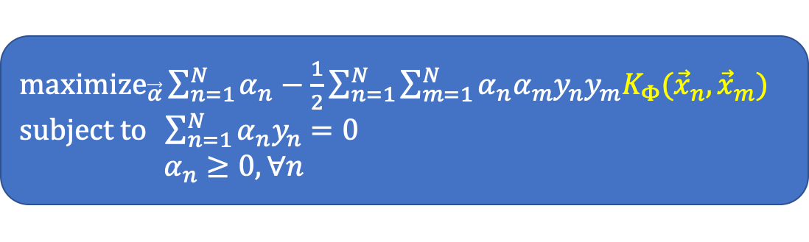
We Only Need $\vec{z}$ Space to Exist
In the discussion of polynomial kernels
We have a target transformation in mind
We want to find a corresponding kernel function
In fact, as long as $K(\vec{x},{\vec{x}}^{′})$ is an inner product in some $\vec{z}$ space, we are good
Just plug in the kernel in the dual formulation
We obtain a linear separator in the corresponding $\vec{z}$ space
${\text{maximize}}_{\vec{α}}\sum_{n=1}^{N}{α_{n}}−\frac{1}{2}\sum_{n=1}^{N}{\sum_{m=1}^{N}{α_{n}α_{m}y_{n}y_{m}K_{Φ}({\vec{x}}_{n},{\vec{x}}_{m})}}$ $\text{subject} \text{to} \sum_{n=1}^{N}{α_{n}y_{n}=0}$ $α_{n}≥0,∀n$

Slide 16
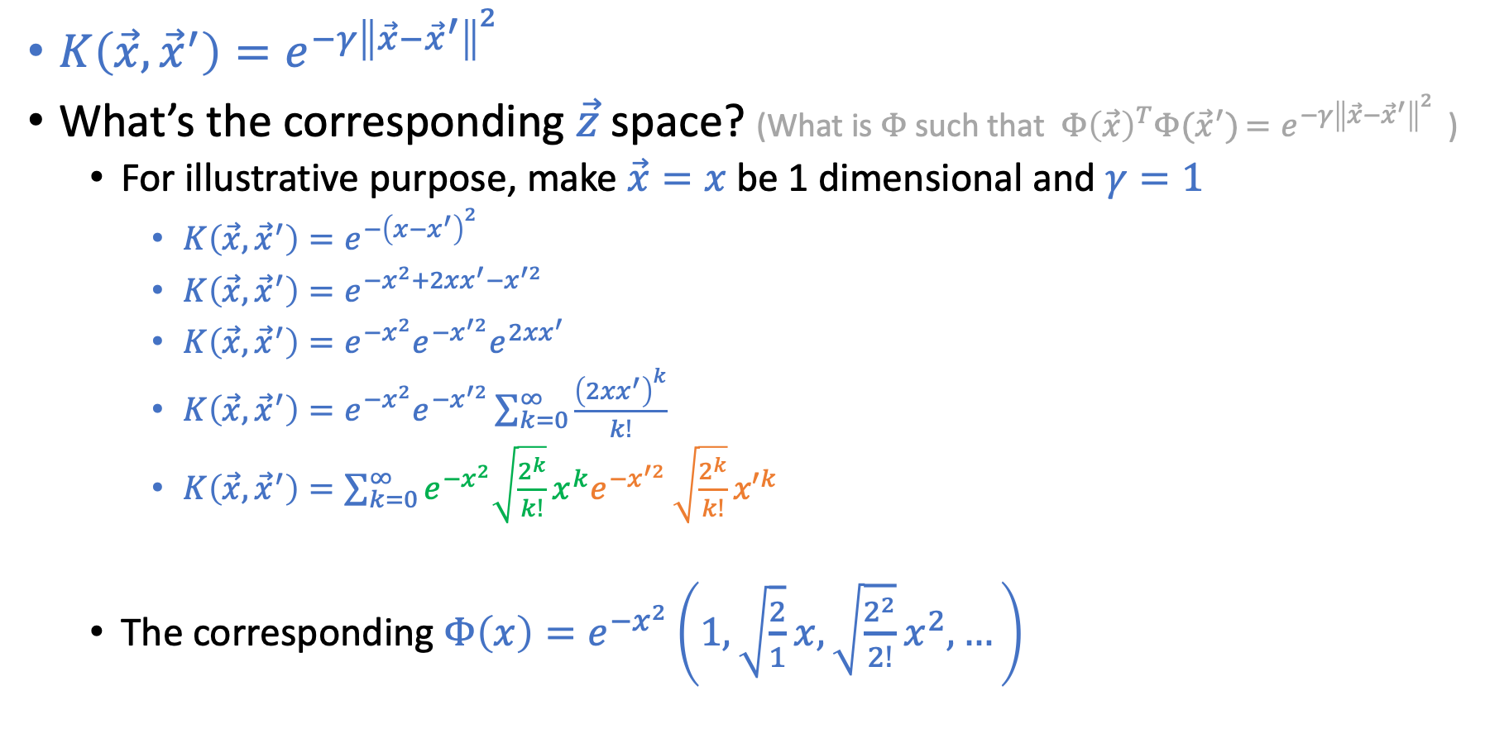
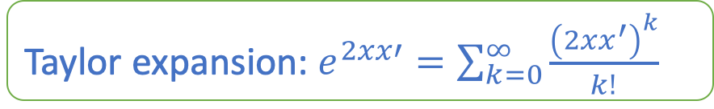
Gaussian RBF Kernel
$K\left(\vec{x},{\vec{x}}^{′}\right)=e^{−γ{\left\|\vec{x}−{\vec{x}}^{′}\right\|}^{2}}{ }$
What’s the corresponding $\vec{z}$ space? (What is$Φ$ such that $Φ{\left(\vec{x}\right)}^{T}Φ({\vec{x}}^{′})=e^{−γ{\left\|\vec{x}−{\vec{x}}^{′}\right\|}^{2}}{ }$)
For illustrative purpose, make $\vec{x}=x$ be 1 dimensional and $γ=1$
$K\left(\vec{x},{\vec{x}}^{′}\right)=e^{−{\left(x−x^{′}\right)}^{2}}{ }$
$K\left(\vec{x},{\vec{x}}^{′}\right)=e^{−x^{2}+2xx^{′}−x^{′2}}$
$K\left(\vec{x},{\vec{x}}^{′}\right)=e^{−x^{2}}e^{−x^{′2}}e^{2xx^{′}}$
$K\left(\vec{x},{\vec{x}}^{′}\right)=e^{−x^{2}}e^{−x^{′2}}\sum_{k=0}^{∞}{\frac{{\left(2xx^{′}\right)}^{k}}{k!}}$
$K\left(\vec{x},{\vec{x}}^{′}\right)=\sum_{k=0}^{∞}{{e^{−x^{2}}\sqrt{\frac{2^{k}}{k!}}x^{k}e}^{−x^{′2}}}\sqrt{\frac{2^{k}}{k!}}{x′}^{k}$
The corresponding $Φ\left(x\right)=e^{−x^{2}}\left(1,\sqrt{\frac{2}{1}}x,\sqrt{\frac{2^{2}}{2!}}x^{2},…\right)$
Taylor expansion: $e^{2xx′}=\sum_{k=0}^{∞}{\frac{{\left(2xx^{′}\right)}^{k}}{k!}}$

Slide 17
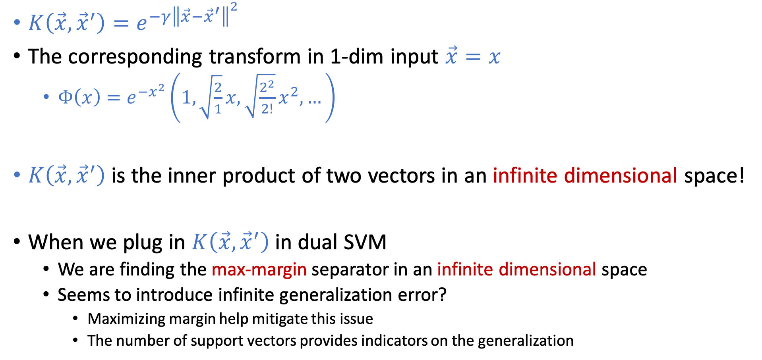
Gaussian RBF Kernel
$K\left(\vec{x},{\vec{x}}^{′}\right)=e^{−γ{\left\|\vec{x}−{\vec{x}}^{′}\right\|}^{2}}{ }$
The corresponding transform in 1-dim input $\vec{x}=x$
$Φ\left(x\right)=e^{−x^{2}}\left(1,\sqrt{\frac{2}{1}}x,\sqrt{\frac{2^{2}}{2!}}x^{2},…\right)$
$K\left(\vec{x},{\vec{x}}^{′}\right)$ is the inner product of two vectors in an infinite dimensional space!
When we plug in $K\left(\vec{x},{\vec{x}}^{′}\right)$ in dual SVM
We are finding the max-margin separator in an infinite dimensional space
Seems to introduce infinite generalization error?
Maximizing margin help mitigate this issue
The number of support vectors provides indicators on the generalization

Slide 18
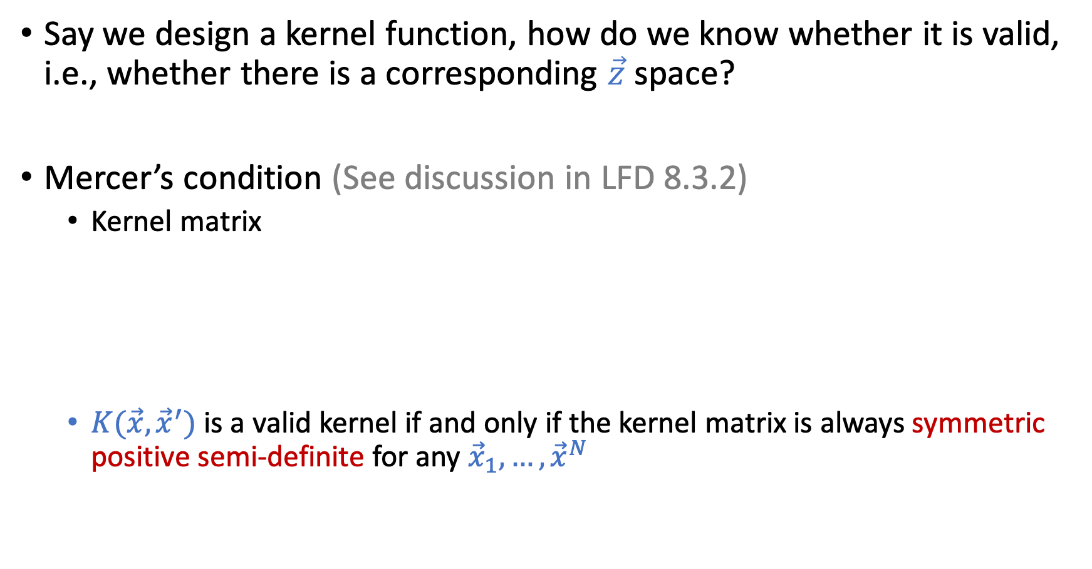
Design Your Own Kernel? [Safe to Skip]
Say we design a kernel function, how do we know whether it is valid, i.e., whether there is a corresponding $\vec{z}$ space?
Mercer’s condition (See discussion in LFD 8.3.2)
Kernel matrix
$K(\vec{x},{\vec{x}}^{′})$ is a valid kernel if and only if the kernel matrix is always symmetric positive semi-definite for any ${\vec{x}}_{1},…,{\vec{x}}^{N}$

Slide 19
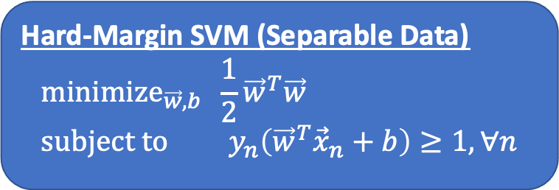
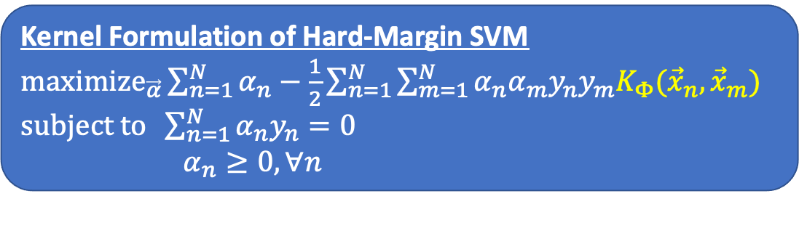
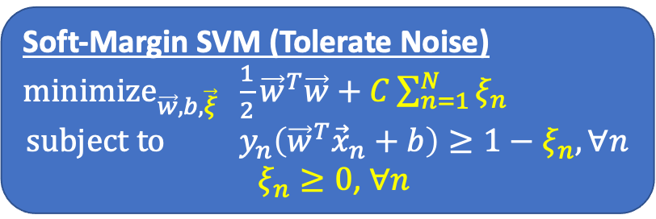
Summary of What We Talked About So Far
Hard-Margin SVM (Separable Data) $${\text{minimize}}_{\vec{w},b} \frac{1}{2}{\vec{w}}^{T}\vec{w} \\ \text{subject} \text{to} y_{n}\left({\vec{w}}^{T}{\vec{x}}_{n}+b\right)≥1, ∀n$$
Margin
Soft-Margin SVM (Tolerate Noise)
${\text{minimize}}_{\vec{w},b,\vec{ξ}} \frac{1}{2}{\vec{w}}^{T}\vec{w}+C\sum_{n=1}^{N}{ξ_{n}}$ $$\text{subject} \text{to} y_{n}\left({\vec{w}}^{T}{\vec{x}}_{n}+b\right)≥1−ξ_{n}, ∀n$$
$ξ_{n}≥0$, $∀n$
Kernel Formulation of Hard-Margin SVM
${\text{maximize}}_{\vec{α}}\sum_{n=1}^{N}{α_{n}}−\frac{1}{2}\sum_{n=1}^{N}{\sum_{m=1}^{N}{α_{n}α_{m}y_{n}y_{m}K_{Φ}({\vec{x}}_{n},{\vec{x}}_{m})}}$ $\text{subject} \text{to} \sum_{n=1}^{N}{α_{n}y_{n}=0}$ $α_{n}≥0,∀n$

Slide 20
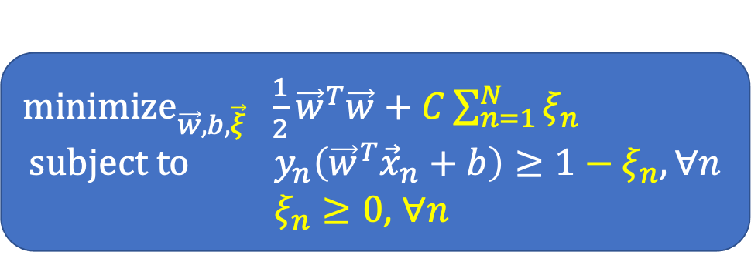
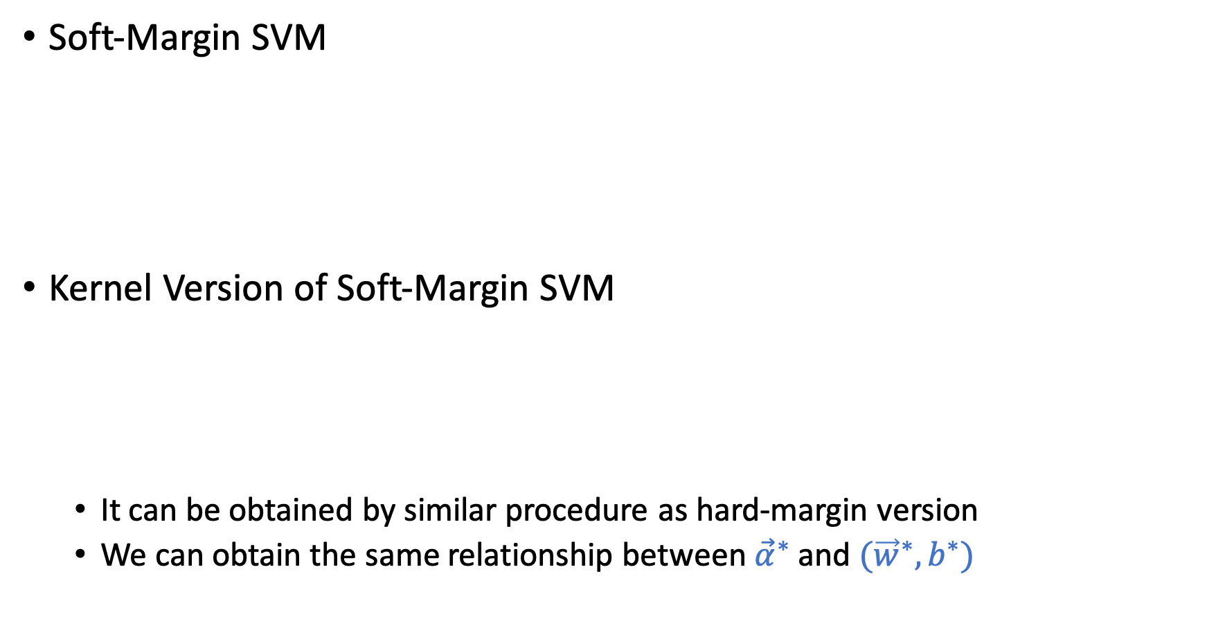
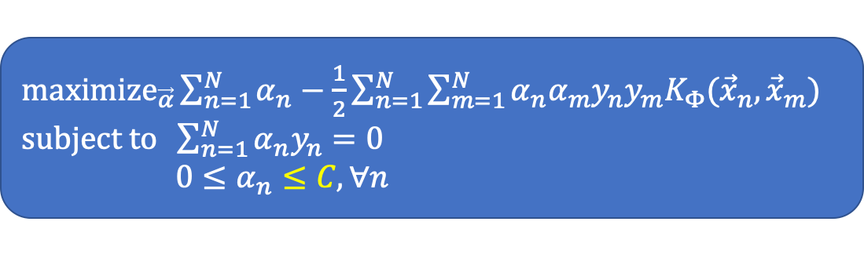
Kernel Version of Soft-Margin SVM
Soft-Margin SVM
Kernel Version of Soft-Margin SVM
It can be obtained by similar procedure as hard-margin version
We can obtain the same relationship between ${\vec{α}}^{∗}$ and $({\vec{w}}^{∗},b^{∗})$
${\text{minimize}}_{\vec{w},b,\vec{ξ}} \frac{1}{2}{\vec{w}}^{T}\vec{w}+C\sum_{n=1}^{N}{ξ_{n}}$ $$\text{subject} \text{to} y_{n}\left({\vec{w}}^{T}{\vec{x}}_{n}+b\right)≥1−ξ_{n}, ∀n$$
$ξ_{n}≥0$, $∀n$
${\text{maximize}}_{\vec{α}}\sum_{n=1}^{N}{α_{n}}−\frac{1}{2}\sum_{n=1}^{N}{\sum_{m=1}^{N}{α_{n}α_{m}y_{n}y_{m}K_{Φ}({\vec{x}}_{n},{\vec{x}}_{m})}}$ $\text{subject} \text{to} \sum_{n=1}^{N}{α_{n}y_{n}=0}$ $0≤α_{n}≤C,∀n$

Slide 21
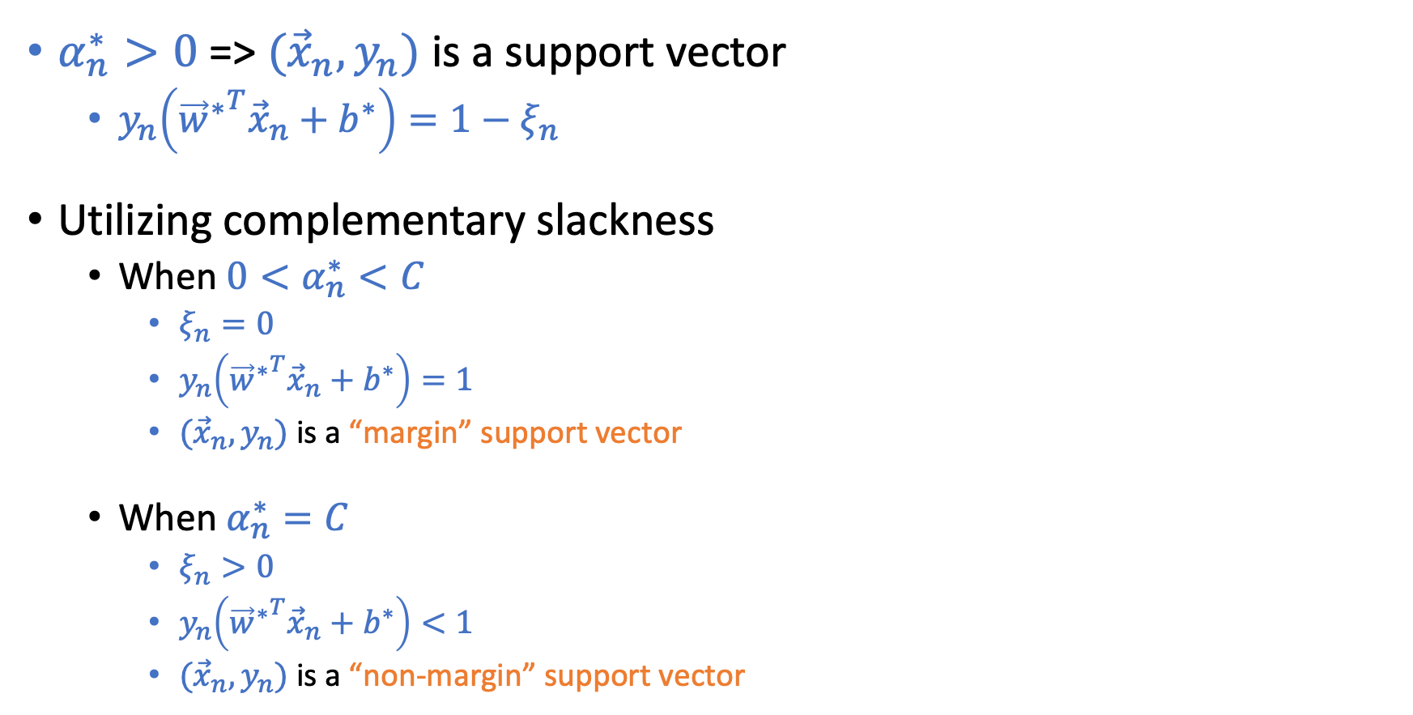
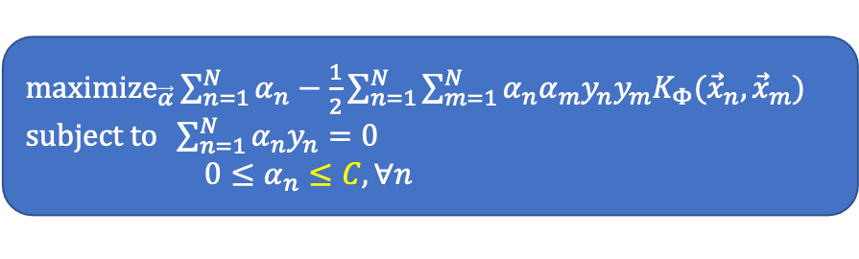
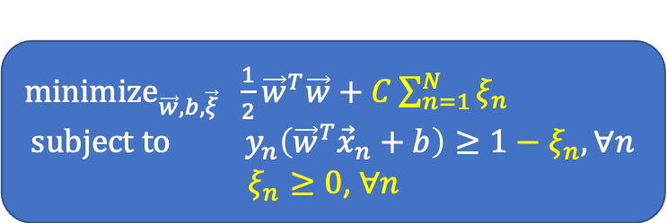
Interpretation of Support Vectors
$α_{n}^{∗}>0$ => $({\vec{x}}_{n},y_{n})$ is a support vector
$y_{n}\left({{\vec{w}}^{∗}}^{T}{\vec{x}}_{n}+b^{∗}\right)=1−ξ_{n}$
Utilizing complementary slackness
When $0<α_{n}^{∗}<C$
$ξ_{n}=0$
$y_{n}\left({{\vec{w}}^{∗}}^{T}{\vec{x}}_{n}+b^{∗}\right)=1$
$({\vec{x}}_{n},y_{n})$ is a “margin” support vector
When $α_{n}^{∗}=C$
$ξ_{n}>0$
$y_{n}\left({{\vec{w}}^{∗}}^{T}{\vec{x}}_{n}+b^{∗}\right)<1$
$({\vec{x}}_{n},y_{n})$ is a “non-margin” support vector
${\text{minimize}}_{\vec{w},b,\vec{ξ}} \frac{1}{2}{\vec{w}}^{T}\vec{w}+C\sum_{n=1}^{N}{ξ_{n}}$ $$\text{subject} \text{to} y_{n}\left({\vec{w}}^{T}{\vec{x}}_{n}+b\right)≥1−ξ_{n}, ∀n$$
$ξ_{n}≥0$, $∀n$
${\text{maximize}}_{\vec{α}}\sum_{n=1}^{N}{α_{n}}−\frac{1}{2}\sum_{n=1}^{N}{\sum_{m=1}^{N}{α_{n}α_{m}y_{n}y_{m}K_{Φ}({\vec{x}}_{n},{\vec{x}}_{m})}}$ $\text{subject} \text{to} \sum_{n=1}^{N}{α_{n}y_{n}=0}$ $0≤α_{n}≤C,∀n$

Slide 22
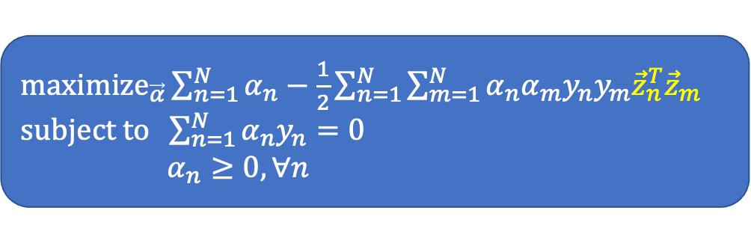
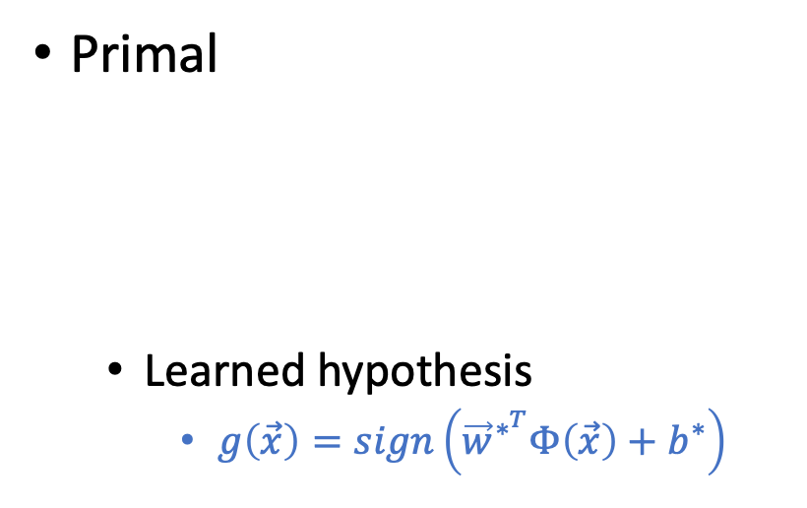
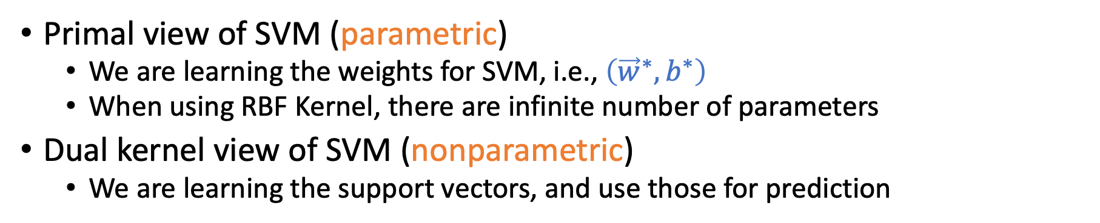
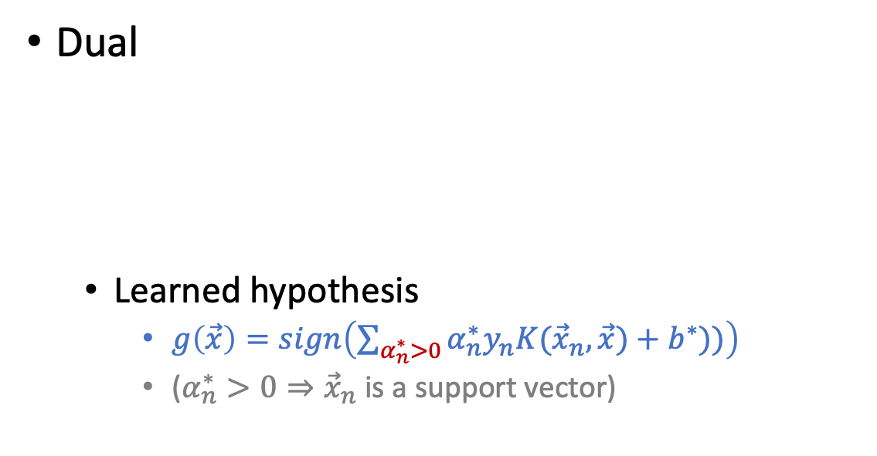
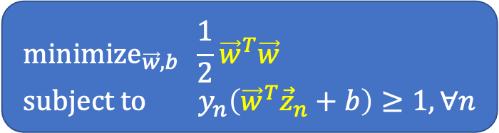
Another Look at Primal vs. Dual SVM
Primal
Learned hypothesis
$g\left(\vec{x}\right)=sign\left({\vec{w}}^{∗^{T}}Φ\left(\vec{x}\right)+b^{∗}\right)$
Dual
Learned hypothesis
$g\left(\vec{x}\right)=sign\left(\sum_{α_{n}^{∗}>0}{α_{n}^{∗}y_{n}K({\vec{x}}_{n},\vec{x})}+b^{∗}))\right)$
($α_{n}^{∗}>0⇒{\vec{x}}_{n}$ is a support vector)
${\text{maximize}}_{\vec{α}}\sum_{n=1}^{N}{α_{n}}−\frac{1}{2}\sum_{n=1}^{N}{\sum_{m=1}^{N}{α_{n}α_{m}y_{n}y_{m}{\vec{z}}_{n}^{T}{\vec{z}}_{m}}}$ $\text{subject} \text{to} \sum_{n=1}^{N}{α_{n}y_{n}=0}$ $α_{n}≥0,∀n$
$${\text{minimize}}_{\vec{w},b} \frac{1}{2}{\vec{w}}^{T}\vec{w} \\ \text{subject} \text{to} y_{n}\left({\vec{w}}^{T}{\vec{z}}_{n}+b\right)≥1, ∀n$$
Primal view of SVM (parametric)
We are learning the weights for SVM, i.e., $\left({\vec{w}}^{∗},b^{∗}\right)$
When using RBF Kernel, there are infinite number of parameters
Dual kernel view of SVM (nonparametric)
We are learning the support vectors, and use those for prediction

Slide 23
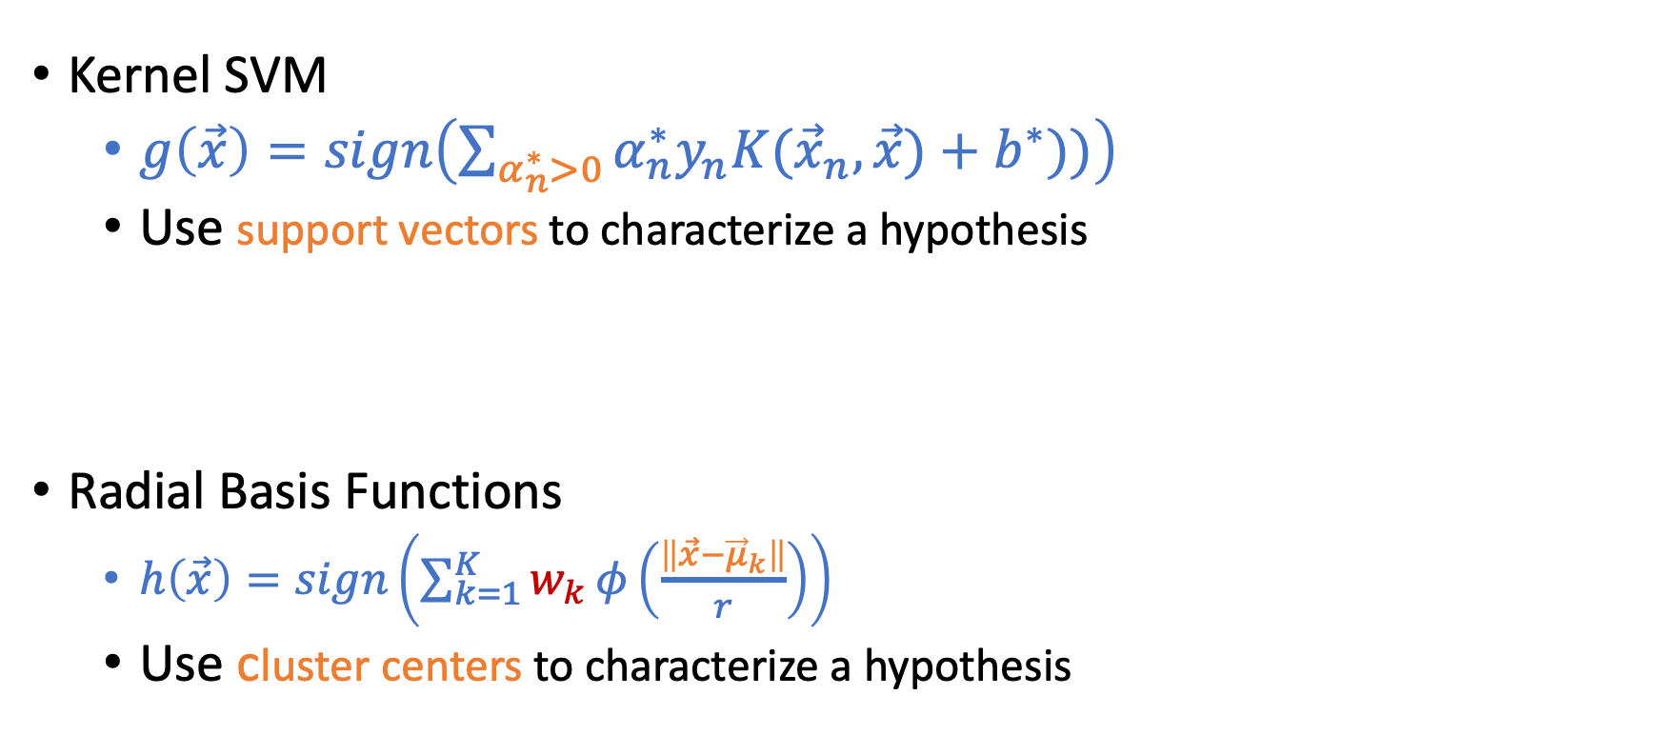
Kernel SVM and Radial Basis Functions
Kernel SVM
$g\left(\vec{x}\right)=sign\left(\sum_{α_{n}^{∗}>0}{α_{n}^{∗}y_{n}K({\vec{x}}_{n},\vec{x})}+b^{∗}))\right)$
Use support vectors to characterize a hypothesis
Radial Basis Functions
$h\left(\vec{x}\right)=sign\left(\sum_{k=1}^{K}{w_{k}}φ\left(\frac{\left\|\vec{x}−{\vec{μ}}_{k}\right\|}{r}\right)\right)$
Use cluster centers to characterize a hypothesis

Slide 24
Neural Networks

Slide 25
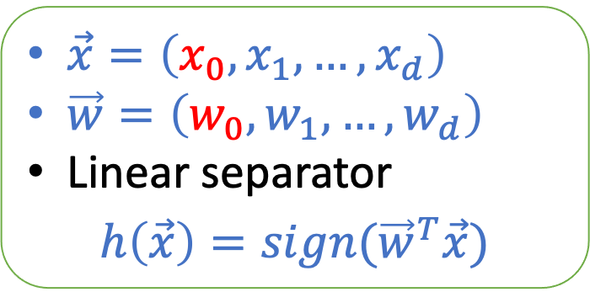
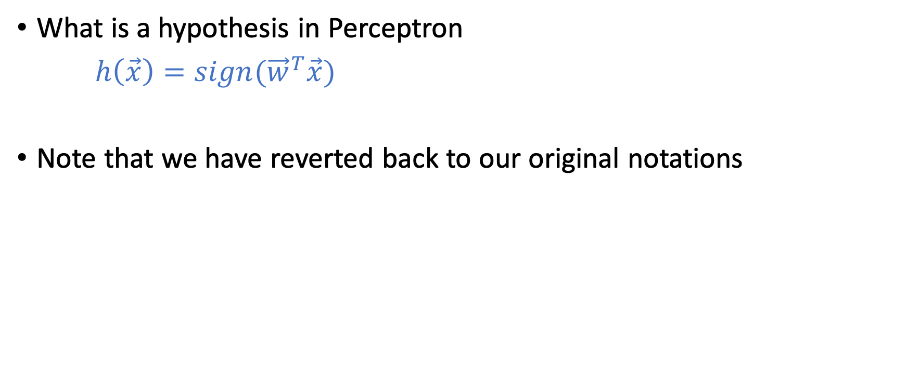
Perceptron
What is a hypothesis in Perceptron
$h\left(\vec{x}\right)=sign({\vec{w}}^{T}\vec{x})$
Note that we have reverted back to our original notations
$\vec{x}=\left(x_{0},x_{1},…,x_{d}\right)$
$\vec{w}=\left(w_{0},w_{1},…,w_{d}\right)$
Linear separator
$$h\left(\vec{x}\right)=sign({\vec{w}}^{T}\vec{x})$$

Slide 26
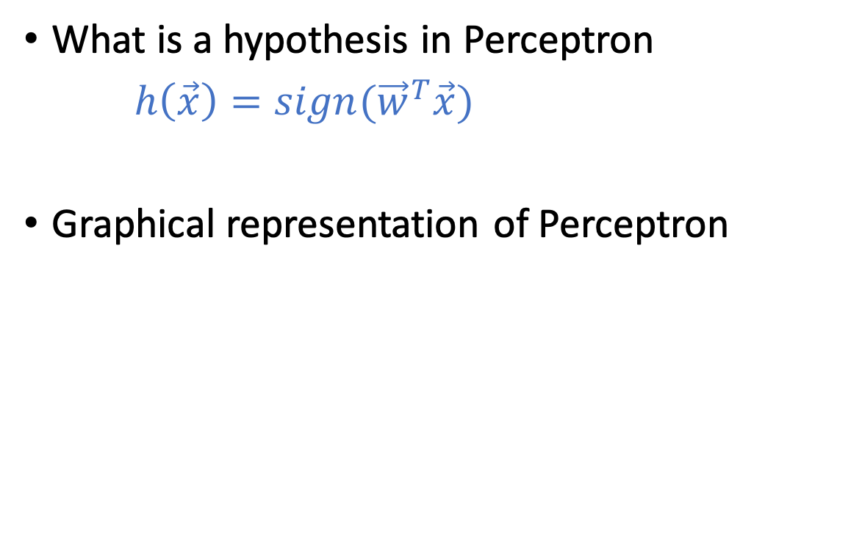
Perceptron
What is a hypothesis in Perceptron
$h\left(\vec{x}\right)=sign({\vec{w}}^{T}\vec{x})$
Graphical representation of Perceptron
Inspired by neurons:
The output signal is triggered when the weighted combination of the inputs is larger than some threshold

Slide 27
The First Perceptron Machine
Mark I Perceptron machine, the first implementation of the perceptron algorithm. (From Wikipedia)
“the embryo of an electronic computer that [the Navy] expects will be able to walk, talk, see, write, reproduce itself and be conscious of its existence.” [1958]

Slide 28
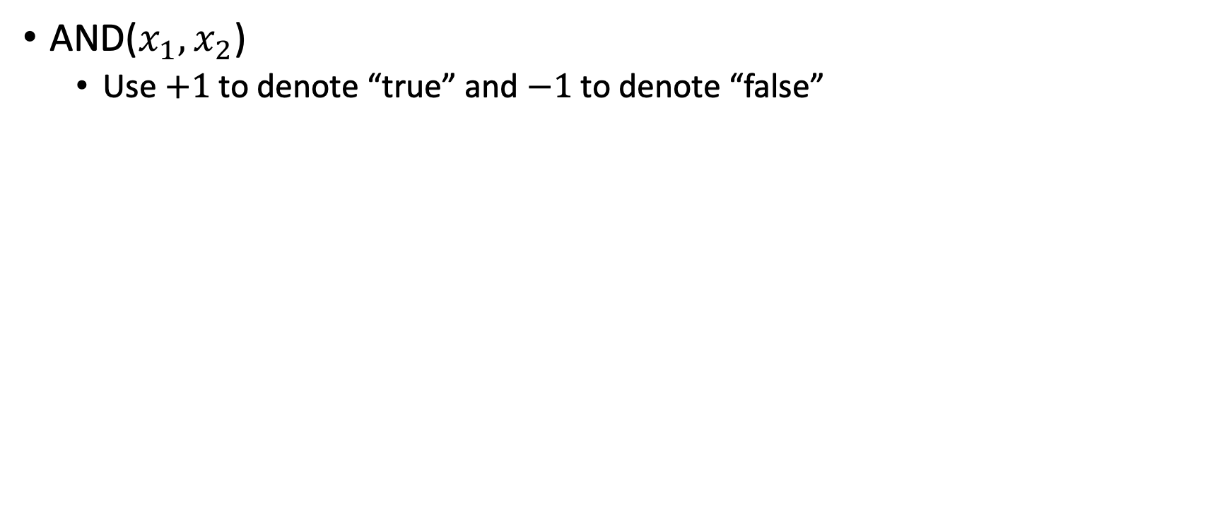
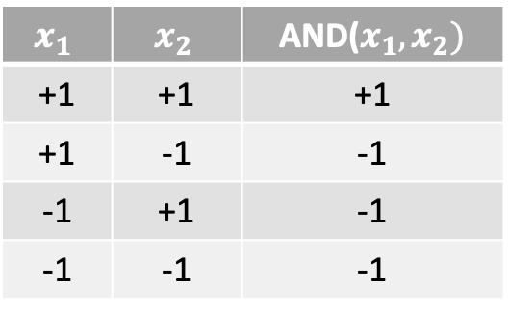
Implement Logic Gates with Perceptron
AND($x_{1},x_{2}$)
Use $+1$ to denote “true” and $−1$ to denote “false”
$$x_{1}$$ | $$x_{2}$$ | AND($x_{1},x_{2})$
+1 | +1 | +1
+1 | -1 | -1
-1 | +1 | -1
-1 | -1 | -1

Slide 29
Implement Logic Gates with Perceptron
AND($x_{1},x_{2}$)
Use $+1$ to denote “true” and $−1$ to denote “false”
$$x_{1}$$ | $$x_{2}$$ | AND($x_{1},x_{2})$
+1 | +1 | +1
+1 | -1 | -1
-1 | +1 | -1
-1 | -1 | -1

Slide 30
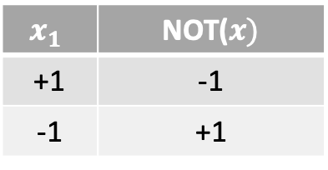


Implement Logic Gates with Perceptron
NOT($x_{1}$)
Use $+1$ to denote “true” and $−1$ to denote “false”
$$x_{1}$$ | NOT($x)$
+1 | -1
-1 | +1
$$\text{NOT}(x_{1})$$

Slide 31
Implement Logic Gates with Perceptron
NOT($x_{1}$)
Use $+1$ to denote “true” and $−1$ to denote “false”
$$x_{1}$$ | NOT($x)$
+1 | -1
-1 | +1
0
-1
$$\text{NOT}(x_{1})$$

Slide 32




Practice: How to Implement OR and XOR?
Use $+1$ to denote “true” and $−1$ to denote “false”
OR($x_{1},x_{2}$)
XOR($x_{1},x_{2}$)
$$x_{1}$$ | $$x_{2}$$ | OR($x_{1},x_{2})$
+1 | +1 | +1
+1 | -1 | +1
-1 | +1 | +1
-1 | -1 | -1
$$x_{1}$$ | $$x_{2}$$ | XOR($x_{1},x_{2})$
+1 | +1 | -1
+1 | -1 | +1
-1 | +1 | +1
-1 | -1 | -1

Slide 33


Implement Logic Gates with Perceptron
OR($x_{1},x_{2}$)
Use $+1$ to denote “true” and $−1$ to denote “false”
$$x_{1}$$ | $$x_{2}$$ | OR($x_{1},x_{2})$
+1 | +1 | +1
+1 | -1 | +1
-1 | +1 | +1
-1 | -1 | -1

Slide 34
Implement Logic Gates with Perceptron
OR($x_{1},x_{2}$)
Use $+1$ to denote “true” and $−1$ to denote “false”
$$x_{1}$$ | $$x_{2}$$ | OR($x_{1},x_{2})$
+1 | +1 | +1
+1 | -1 | +1
-1 | +1 | +1
-1 | -1 | -1

Slide 35



Implement Logic Gates with Perceptron
XOR($x_{1},x_{2}$)
Use $+1$ to denote “true” and $−1$ to denote “false”
$$x_{1}$$ | $$x_{2}$$ | XOR($x_{1},x_{2})$
+1 | +1 | -1
+1 | -1 | +1
-1 | +1 | +1
-1 | -1 | -1
$$\text{XOR}(x_{1},x_{2})$$

Slide 36
Implement Logic Gates with Perceptron
XOR($x_{1},x_{2}$)
Use $+1$ to denote “true” and $−1$ to denote “false”
It is impossible to implement XOR
using a single perceptron
(draw the points in the 2-D space,
you will see they are not linearly separable)
$$x_{1}$$ | $$x_{2}$$ | XOR($x_{1},x_{2})$
+1 | +1 | -1
+1 | -1 | +1
-1 | +1 | +1
-1 | -1 | -1
Stronger version: It is impossible to implement XOR
using a single layer of perceptrons

Slide 37
Multi-Layer Perceptron

Slide 38


Representing Boolean Operations
AND$\left(x_{1},x_{2}\right)→$ $x_{1}x_{2}$
OR$\left(x_{1},x_{2}\right)→x_{1}+x_{2}$
NOT($x_{1})→{\overline{x}}_{1}$
XOR$\left(x_{1},x_{2}\right)→x_{1}{\overline{x}}_{2}+{\overline{x}}_{1}x_{2}$
$$x_{1}$$ | $$x_{2}$$ | XOR($x_{1},x_{2})$
+1 | +1 | -1
+1 | -1 | +1
-1 | +1 | +1
-1 | -1 | -1

Slide 39




Implementing XOR
XOR$\left(x_{1},x_{2}\right)→x_{1}{\overline{x}}_{2}+{\overline{x}}_{1}x_{2}$
$$\text{XOR}(x_{1},x_{2})$$
$$x_{1}{\overline{x}}_{2}$$
$${\overline{x}}_{1}x_{2}$$

Slide 40




Implementing XOR
XOR$\left(x_{1},x_{2}\right)→x_{1}{\overline{x}}_{2}+{\overline{x}}_{1}x_{2}$
$$\text{XOR}(x_{1},x_{2})$$
$$x_{1}$$
$$x_{1}{\overline{x}}_{2}$$
$$x_{2}$$
$${\overline{x}}_{1}x_{2}$$

Slide 41
Multi-Layer Perceptron (MLP)
Input layer
Hidden layer(s)
Output layer
$$\text{XOR}(x_{1},x_{2})$$
$$x_{1}$$
$$x_{1}{\overline{x}}_{2}$$
$$x_{2}$$
$${\overline{x}}_{1}x_{2}$$
Feed-forward network

Slide 42

The Power of Multi-Layer Perceptron (MLP)
We now know that we can implement XOR by introducing the hidden layer in MLP. But generally how powerful is MLP?
Universal approximation theorem
a feed-forward network with a single hidden layer containing a finite number of neurons can approximate continuous functions on compact subsets of$ℝ^{n}$, under mild assumptions on the activation function.
Three-layer MLP can approximate ANY continuous target function!
Notes:
Activation function – non-constant, bounded, continuous

Slide 43
Informal Intuitions of Universal Approximation
A continuous separator can be ”decomposed” into linear separators

Slide 44





How to Learn MLP From Data?
Given $D$ and the network structure, how to learn the “weights” (i.e., the weight vectors of every Perceptron)?
Computationally challenging due to the ”sign” function
$$x_{1}$$
$$x_{1}{\overline{x}}_{2}$$
$$x_{2}$$
$${\overline{x}}_{1}x_{2}$$

Slide 45

Neural Networks
A softened version of multi-layer Perceptron (MLP)
$θ$: activation function
(Specify the “activation” of the neuron)
Next lecture: formally introduce neural networks and how to learn it from data

Slide 46
Notations of Neural Networks (NN)

Slide 47

Neural Networks
$θ$: activation function
(Specify the “activation” of the neuron)
We mostly focus on feed-forward network structure

Slide 48



Activation Function
Think about a single neuron (linear model)
Compute the linear signal $s={\vec{w}}^{T}\vec{x}$
Transform it to what we need in the output (sign, linear, or sigmoid)
In Neural networks, outputs of some nodes are inputs of some others
Activation function decides how to do this transformation
 | Domain | Model
Linear Classification | $$y∈\{−1,+1\}$$ | $$H=\{h\left(\vec{x}\right)={sign(\vec{w}}^{T}\vec{x})\}$$
Linear Regression | $$y∈ℝ$$ | $$H=\{h\left(\vec{x}\right)={\vec{w}}^{T}\vec{x}\}$$
Logistic Regression | $$y∈[0,1]$$ | $$H=\{h\left(\vec{x}\right)={θ(\vec{w}}^{T}\vec{x})\}$$
$$θ\left(s\right)=\frac{e^{s}}{1+e^{s}}$$

Slide 49

Activation Function
Activation functions in Neural Networks
sign function:
hard to optimize
linear function:
the entire neural network is linear
One potential option: having a “softened” version of sign function
$$θ$$

Slide 50

Activation Function
Activation functions in Neural Networks
sign function: hard to optimize
linear function: the entire neural network is linear
tanh: a softened version of sign
$\tanh\left(s\right)=\frac{e^{s}−e^{−s}}{e^{s}+e^{−s}}$
Examine $\tanh{(s)}$
$\tanh\left(s\right)=\left\{\begin{aligned}1 \text{when} s→∞ \\ 0 \text{when} s=0 \\ −1 \text{when} \text{s}→∞\end{aligned}\right.$
For $θ\left(s\right)=tanh⁡(s)$, $θ^{′}\left(s\right)=1−θ{\left(s\right)}^{2}$

Slide 51

Activation Function
There are other activation functions with different benefits. However, it doesn’t impact our discussions, and we’ll focus on $tanh⁡()$ as the activation function
A few more examples
https://towardsdatascience.com/activation-functions-neural-networks-1cbd9f8d91d6

Slide 52

Notations of Neural Networks (NN)
Layers $ℓ=0$ to $L$
Layer 0: input layer
Layer 1 to $L−1$: hidden layers
Layer $L$: output layer
$d^{(ℓ)}$: dimension of layer $ℓ$
# nodes (excluding 1s) in the layer
${\vec{x}}^{(ℓ)}:$ the nodes in layer $ℓ$
${\vec{x}}^{(0)}$ is the input feature $\vec{x}$
$x_{i}^{(ℓ)}$ is the $i$-th node in layer $ℓ$

Slide 53

Notations of Neural Networks (NN)
A hypothesis in linear model is specified by the weights $\{w_{i}\}$
Similarly, a hypothesis in NN is characterized by the weights ${\{w}_{i,j}^{(ℓ)}\}$
$1≤ℓ≤L$ layers
$0≤i≤d^{(ℓ−1)}$ inputs
$1≤j≤d^{\left(ℓ\right)}$ outputs
Notes:
4x2 + 3x1 = 11

Slide 54

Notations of Neural Networks (NN)
Notations so far:
$d^{(ℓ)}$: dimension of layer $ℓ$
${\vec{x}}^{(ℓ)}:$ the nodes in layer $ℓ$
$w_{i,j}^{(ℓ)}$: weights; characterize hypothesis in NN
Lastly, linear signal $s_{j}^{ (ℓ)}=\sum_{i=0}^{d^{(ℓ−1)}}{w_{i,j}^{(ℓ)}x_{i}^{(ℓ−1)}}$
By definition: $x_{j}^{(ℓ)}=θ\left(s_{j}^{ℓ}\right)$
Notes:
4x2 + 3x1 = 11

Slide 55
Notations of Neural Networks (NN)
Notations so far:
$d^{(ℓ)}$: dimension of layer $ℓ$
${\vec{x}}^{(ℓ)}:$ the nodes in layer $ℓ$
$w_{i,j}^{(ℓ)}$: weights; characterize hypothesis in NN
Lastly, linear signal $s_{j}^{ (ℓ)}=\sum_{i=0}^{d^{(ℓ−1)}}{w_{i,j}^{(ℓ)}x_{i}^{(ℓ−1)}}$
By definition: $x_{j}^{(ℓ)}=θ\left(s_{j}^{ℓ}\right)$
Notes:
4x2 + 3x1 = 11

